Slide 1
Modelling of transient behavior of a diode - switching OFF
EE2503
Adarsh A (EE23BTECH11203)
R.V.S.S Varun (EE23BTECH11220)
P Srikar Varma (EE23BTECH11215)
Kalyan P (EE23BTECH11216)
Manoj Kumar (EE23BTECH11211)
Harsha Vardhan Kumar (EE23BTECH11214)

Slide 2
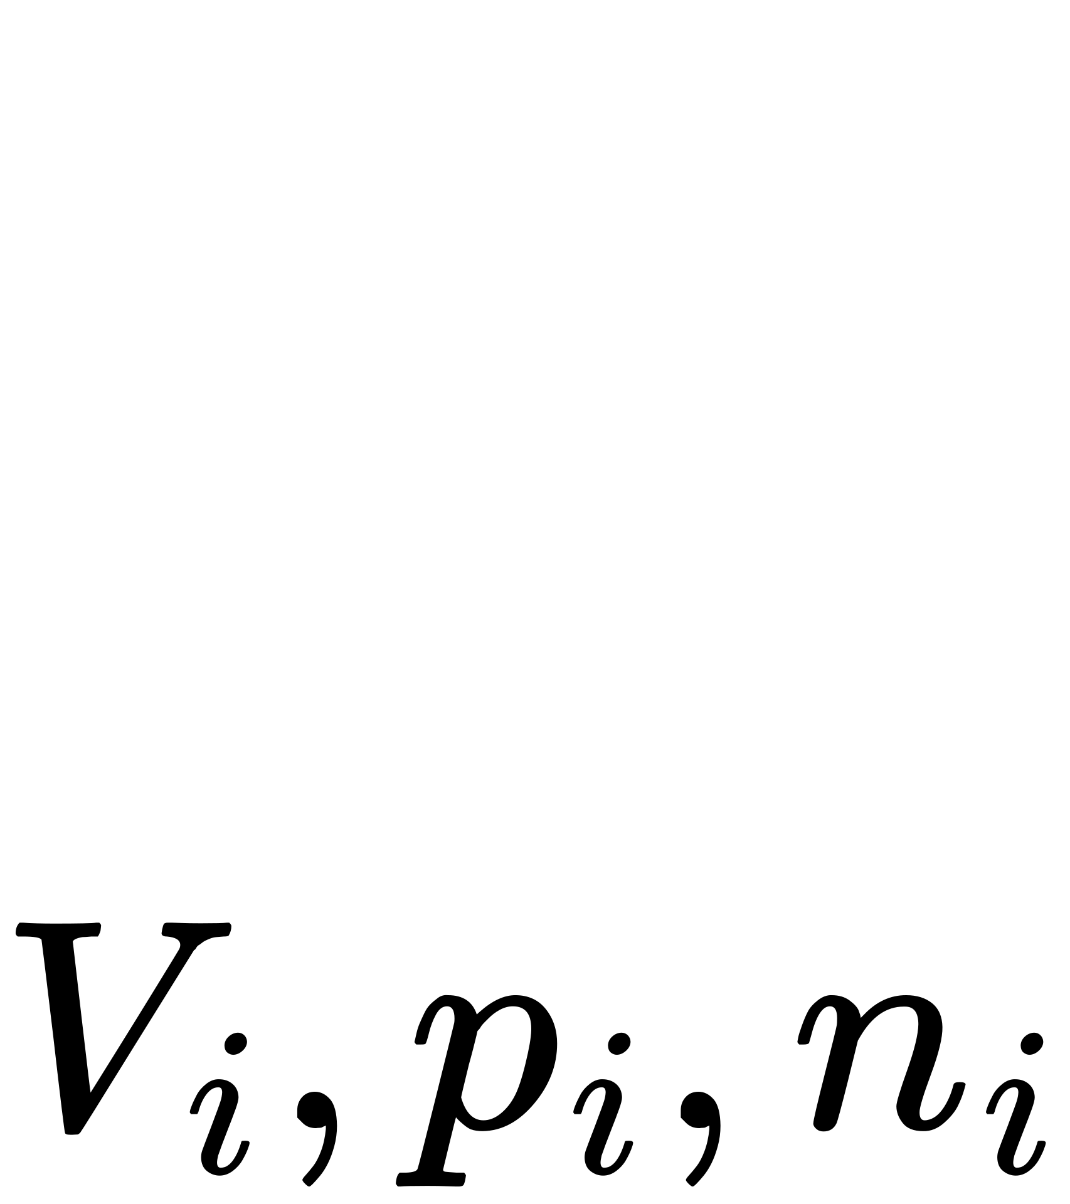
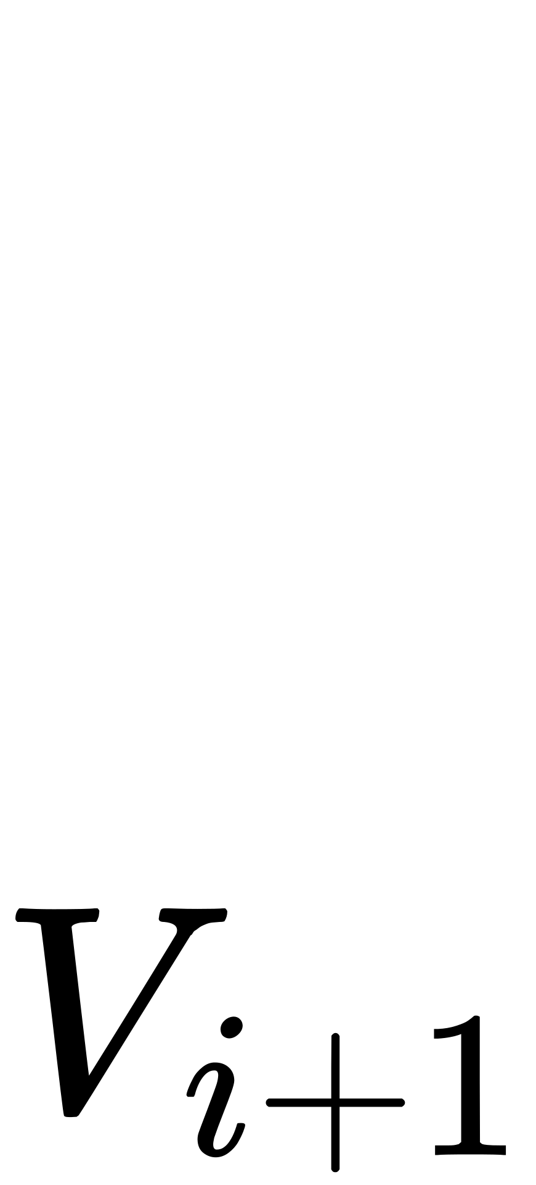
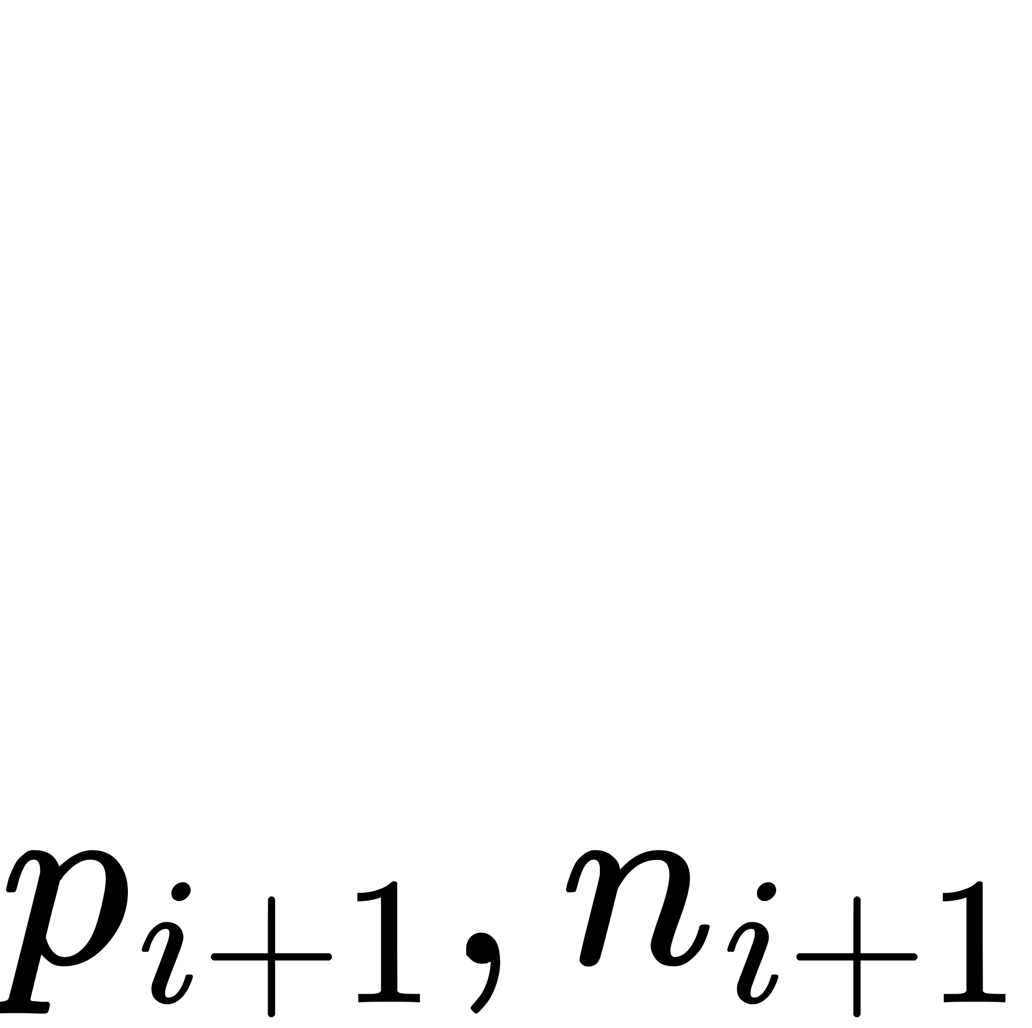
Poission Solver
Poission Solver
Carrier continuity
Convergence Check
No
yes

Slide 3


Poission Solver

Slide 4
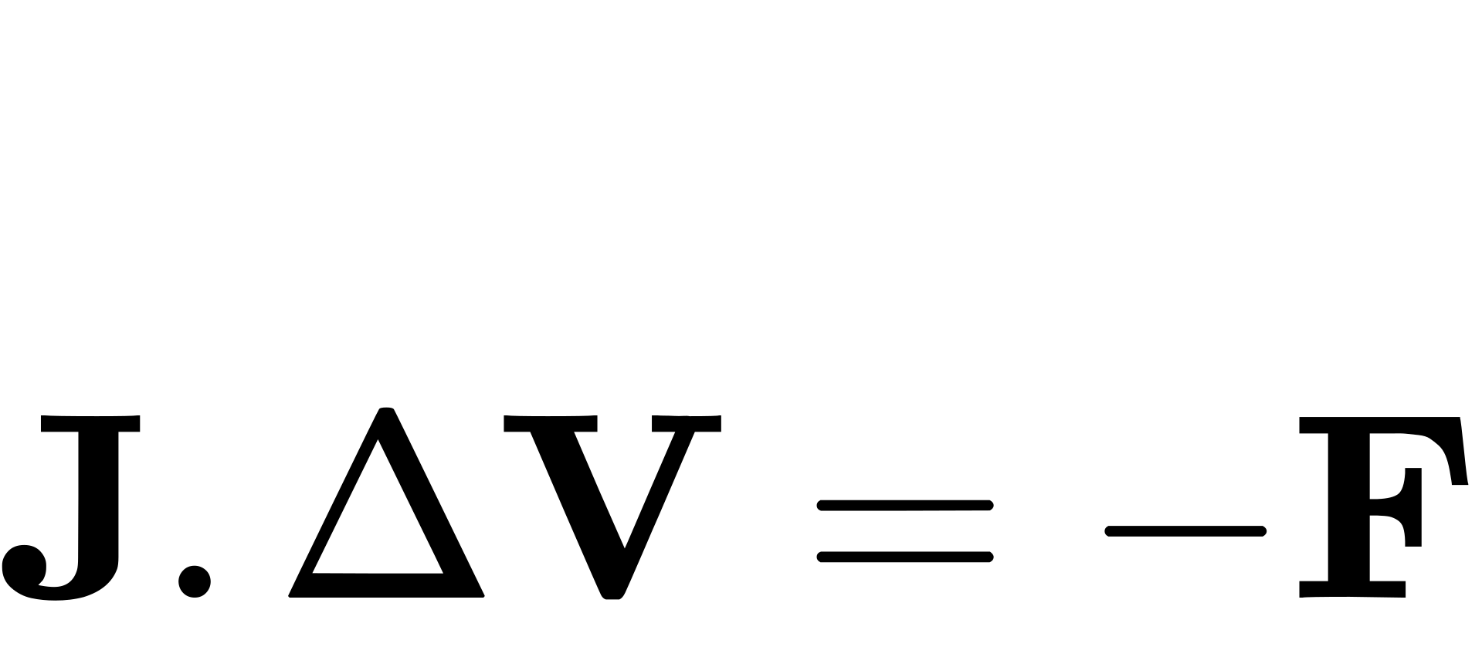
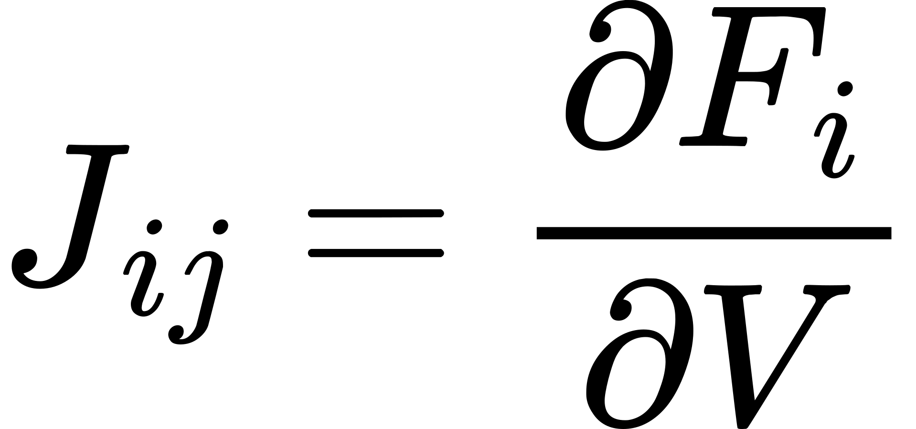


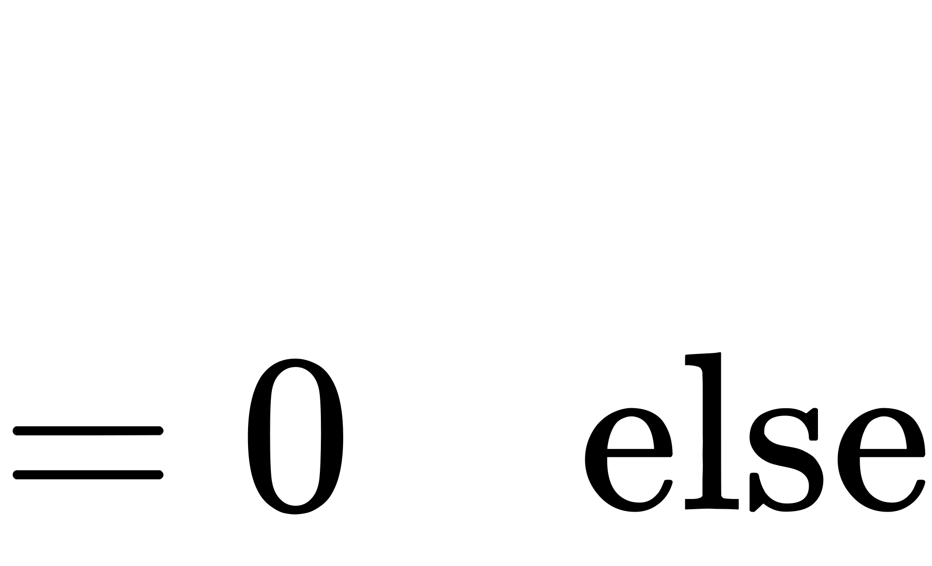


By using Newton Raphson method for non linear system of equations
Where
also

Slide 5


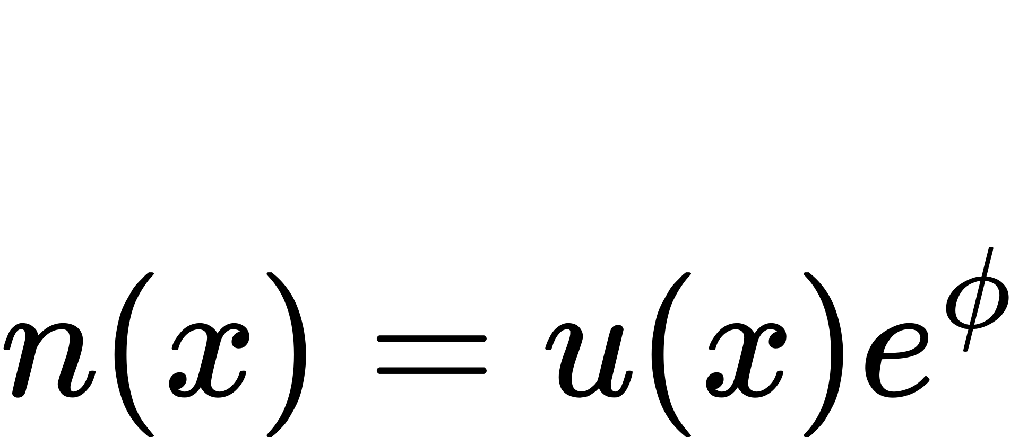


Scharfetter Gummel Scheme

Slide 6








Slide 7


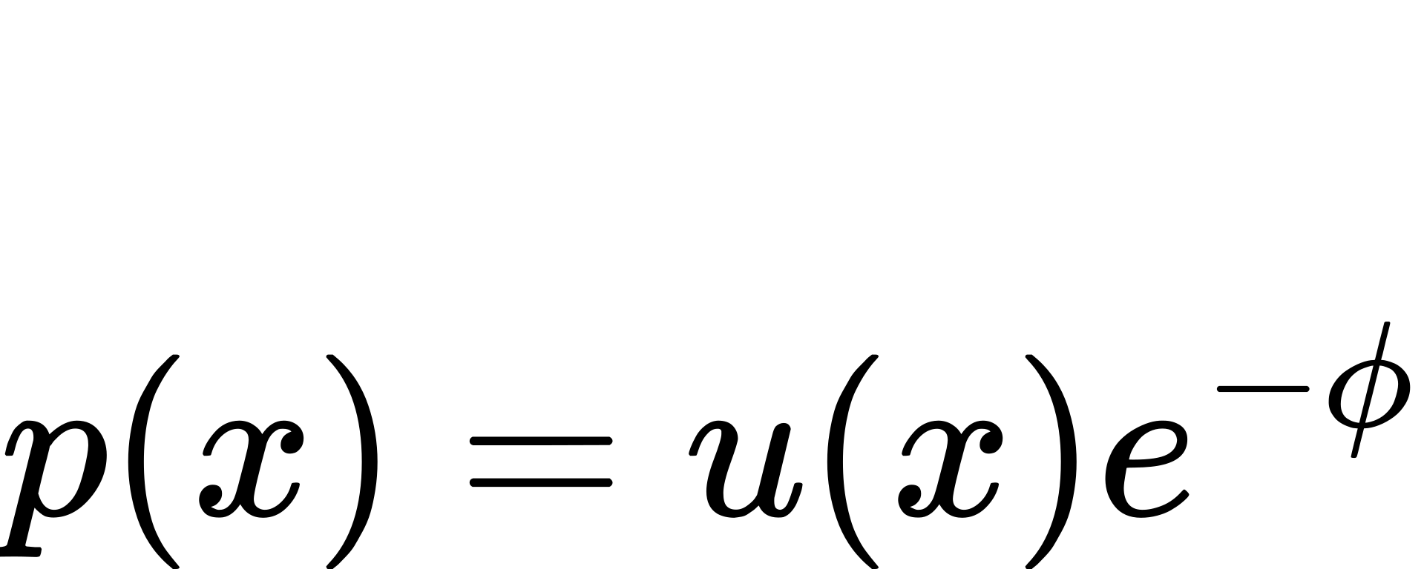





Slide 8







Slide 9







Slide 10




Crank Nicolson Method

